Slide 1
Food Ordering App

Slide 2
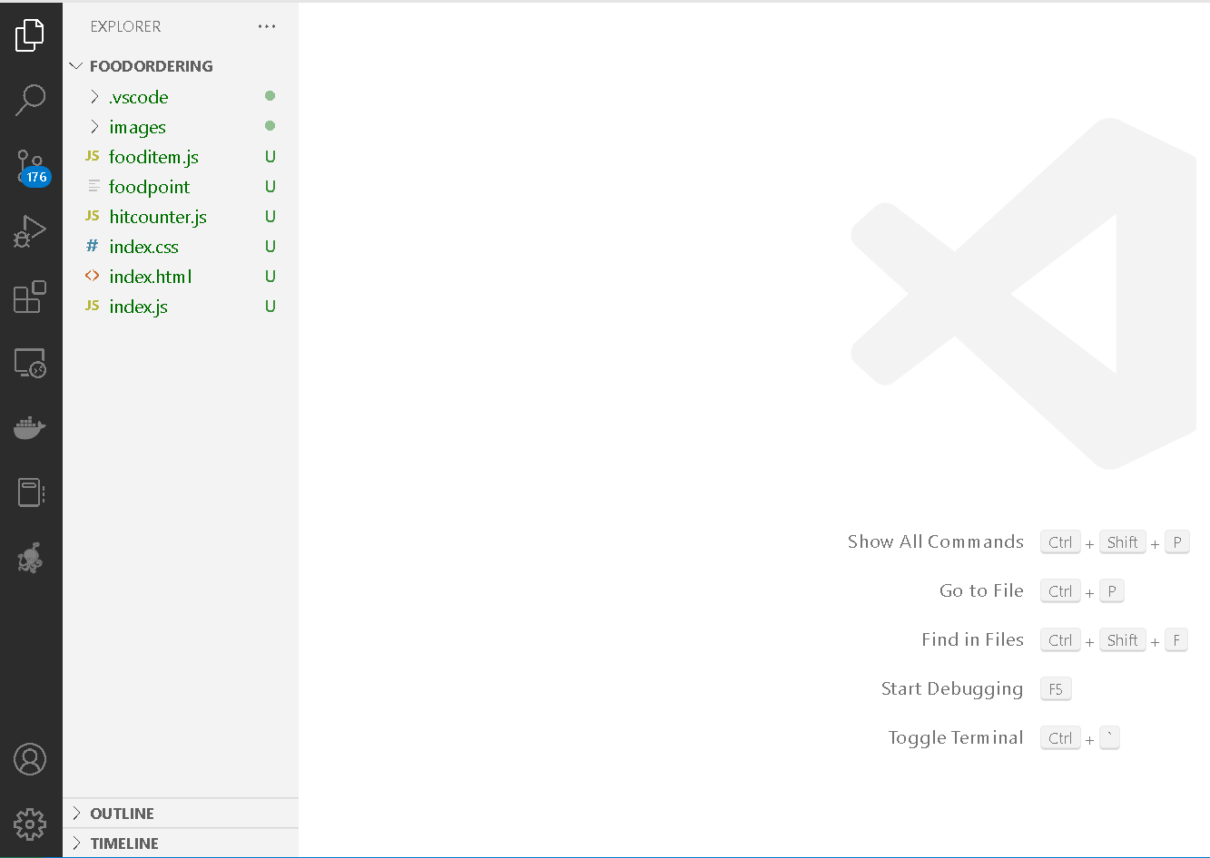
The project structure

Slide 3
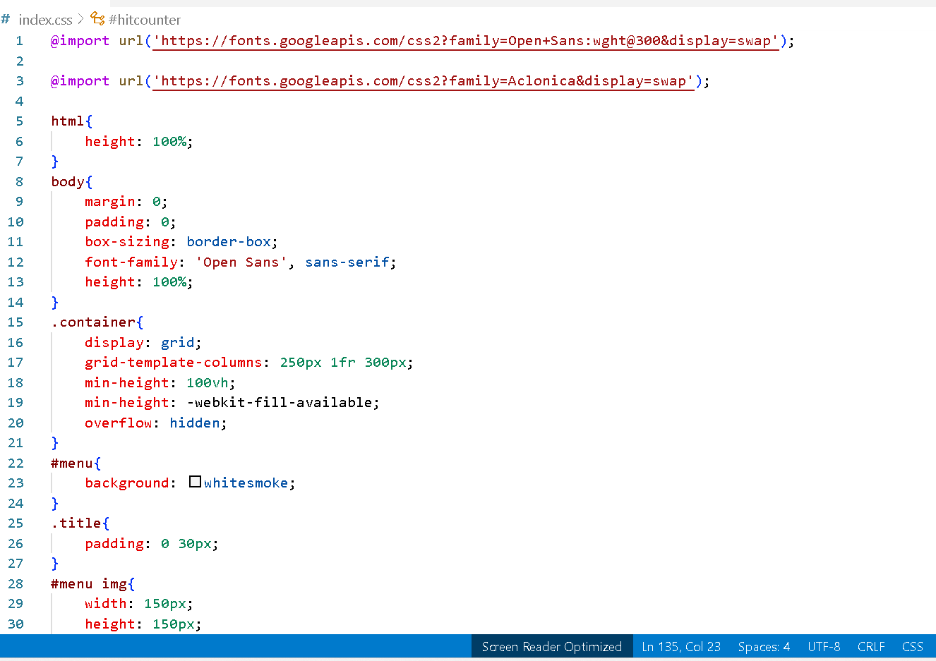
index.css

Slide 4
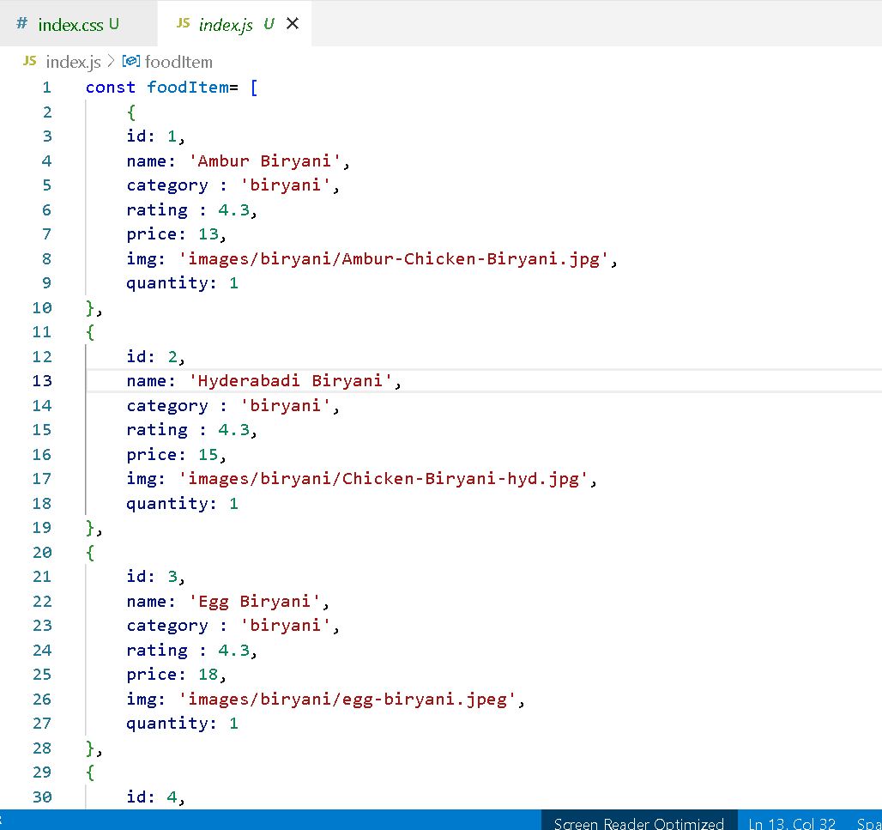
index.js

Slide 5
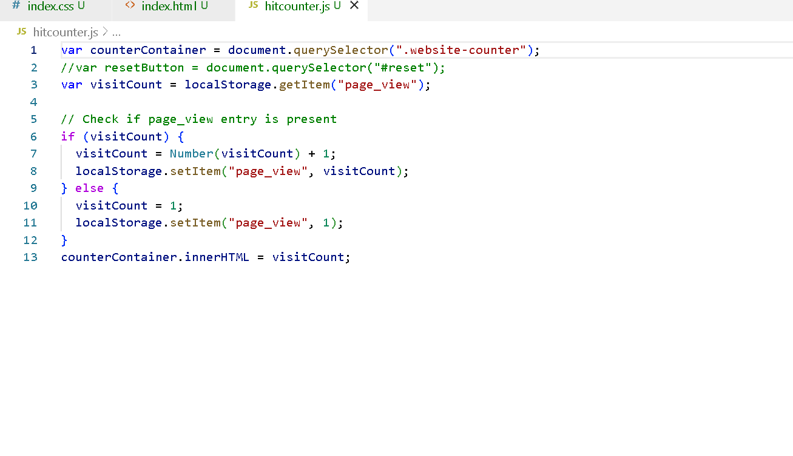
hitcouter.js

Slide 6
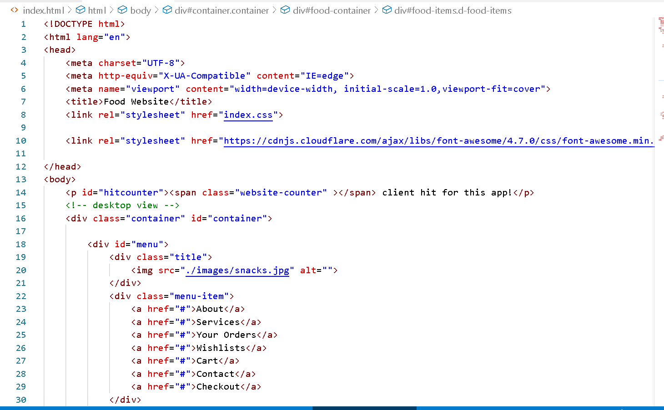
index.html

Slide 7
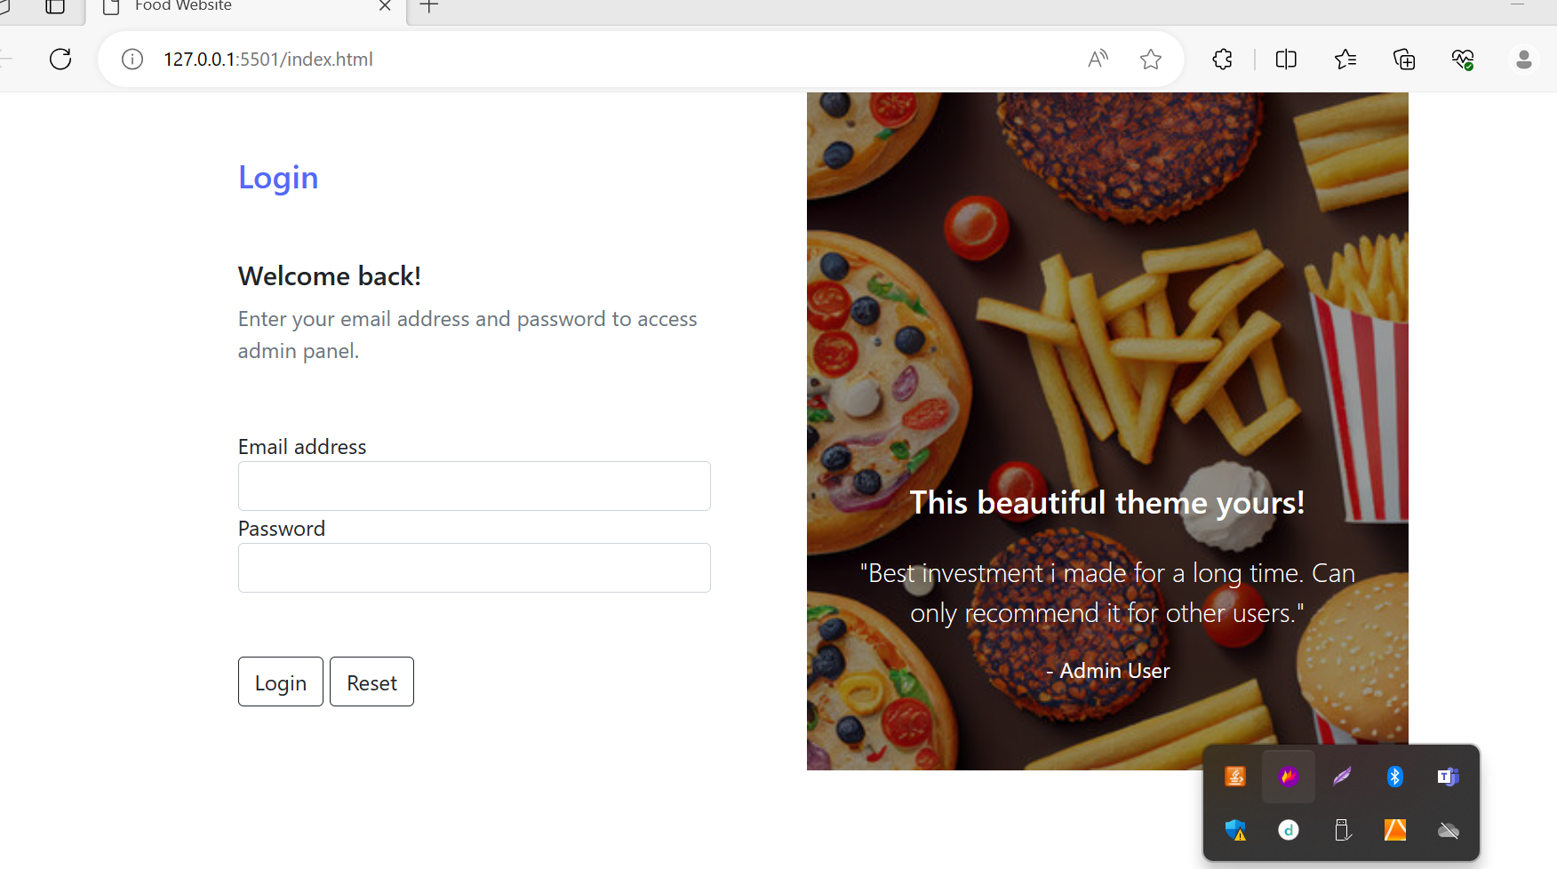

Slide 8
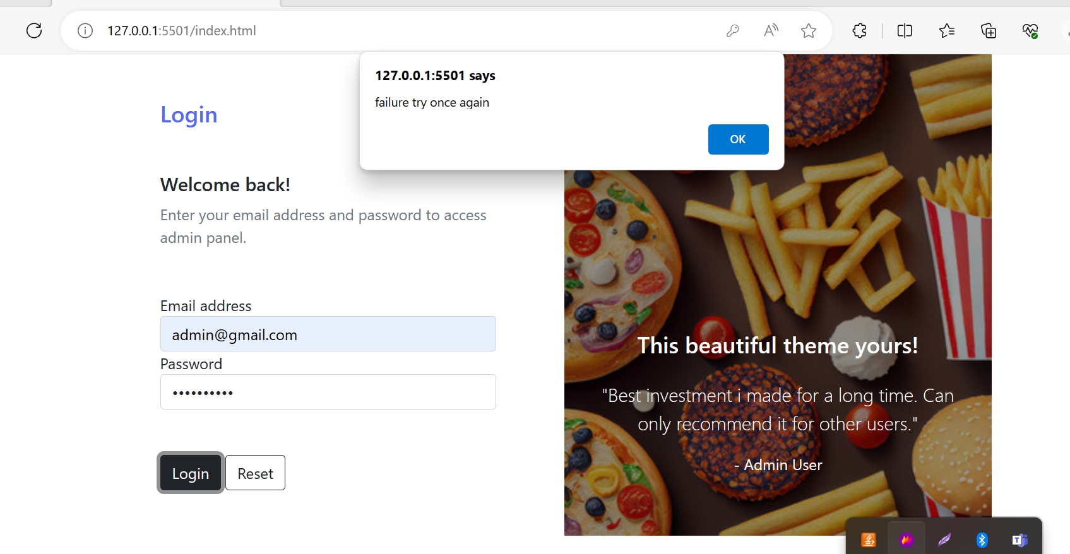

Slide 9
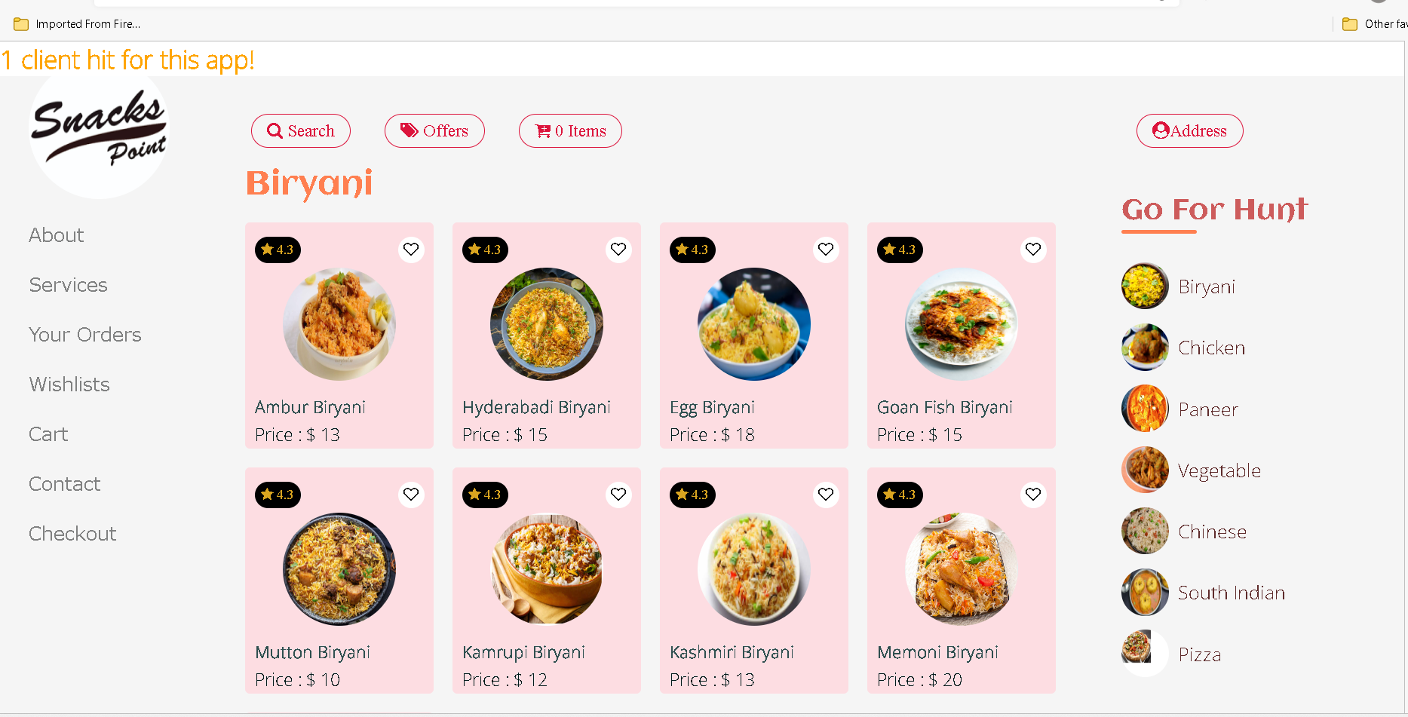
Run the index.html page

Slide 10
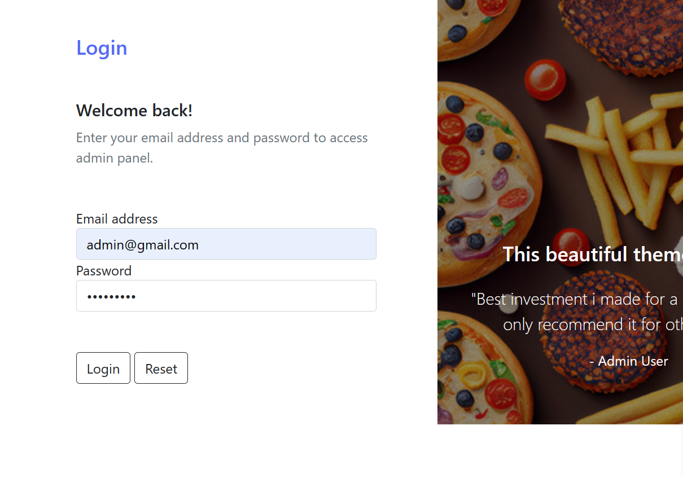
Correct email id and password as
Emailed : admin@gmail.com
Password : admin@123

Slide 11
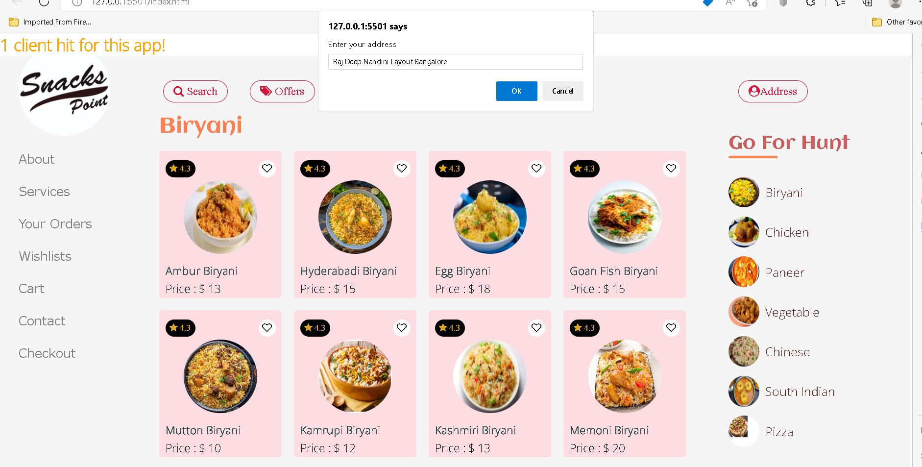
You can see only one client access this app
Now you can add the address. This details hold for temporary purpose.

Slide 12
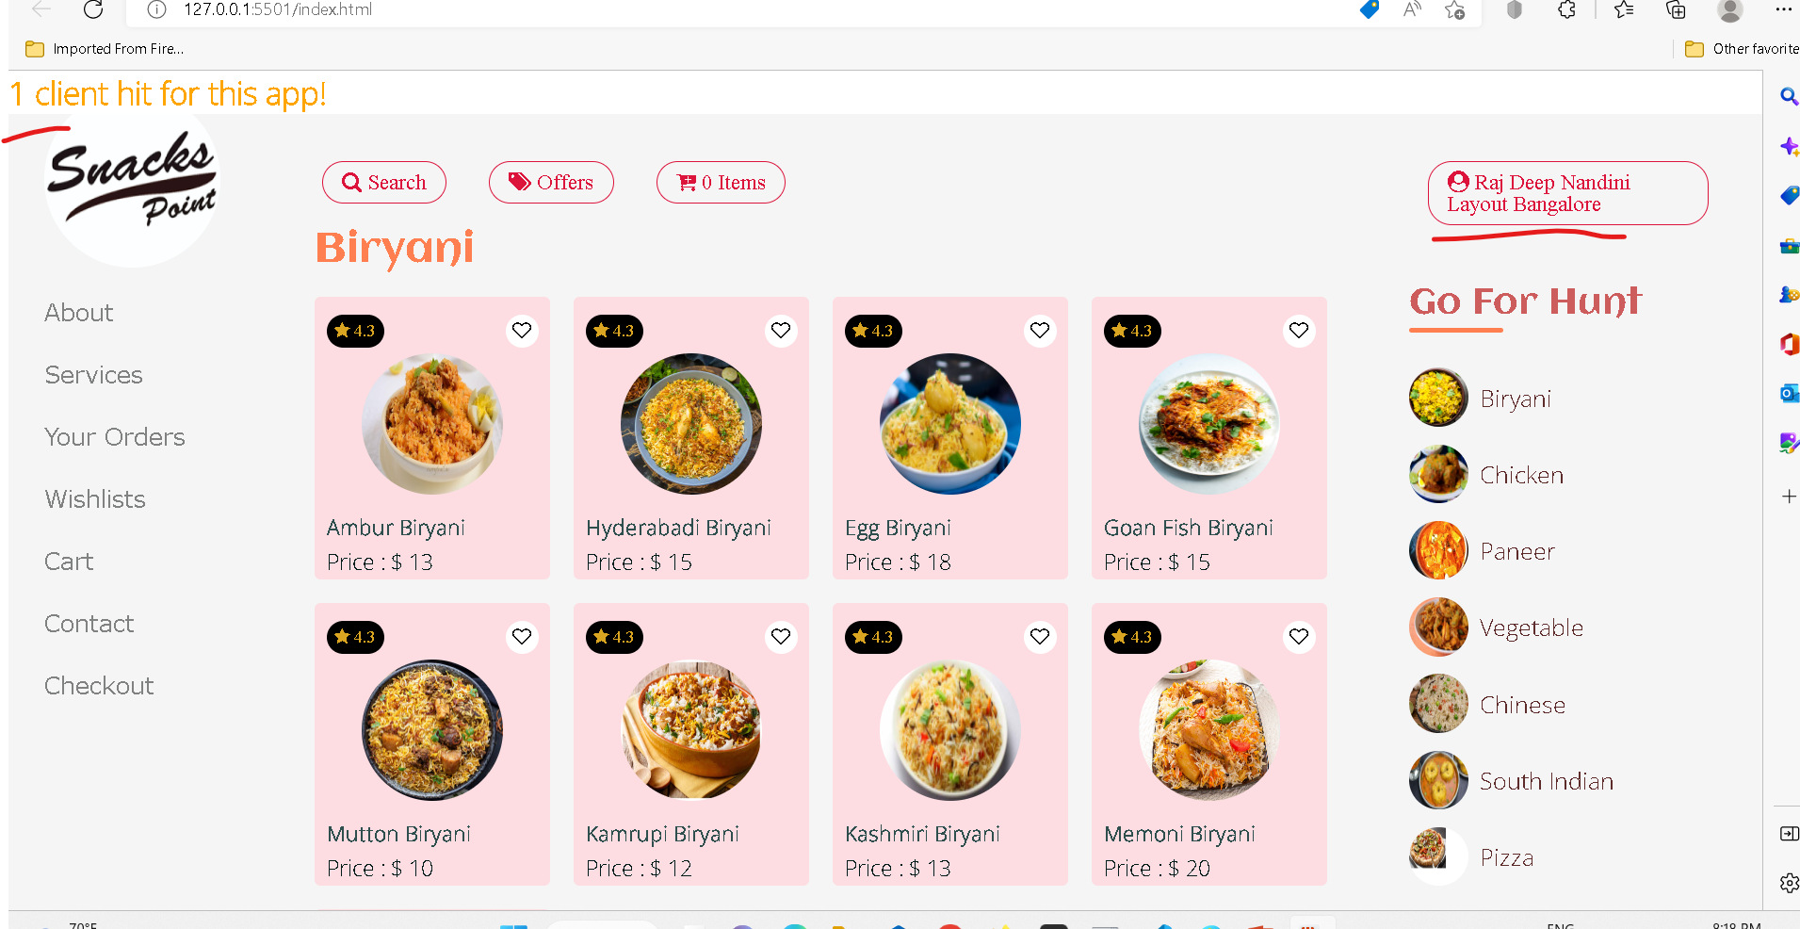
After added address

Slide 13
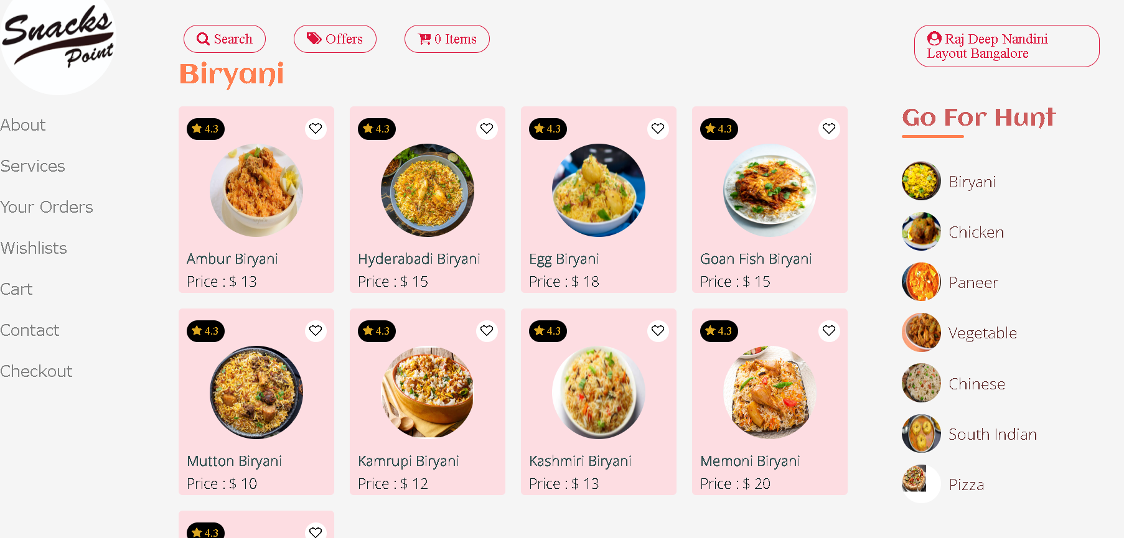
Now search item from category

Slide 14
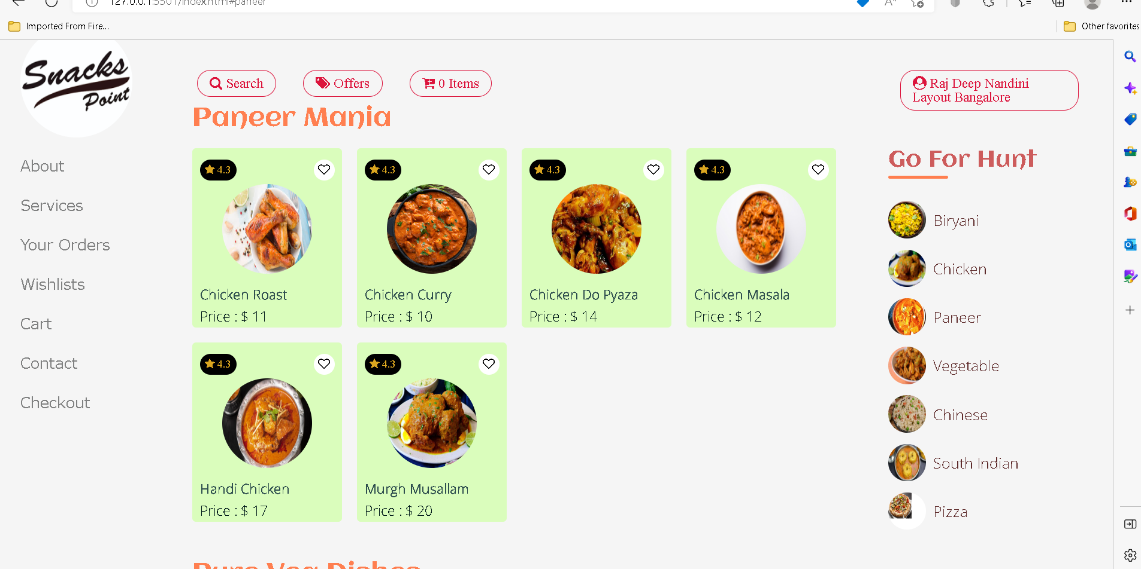
After selected paneer category

Slide 15
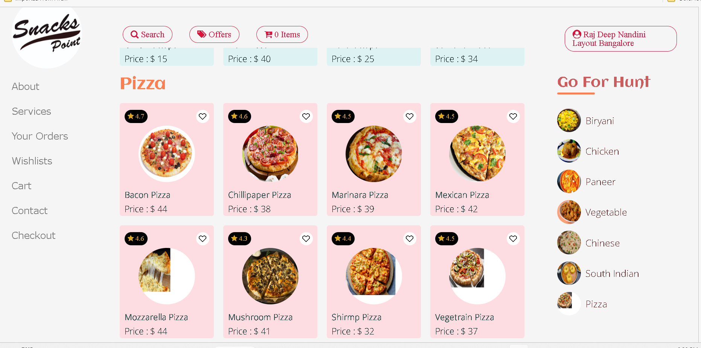
After selected pizza category

Slide 16
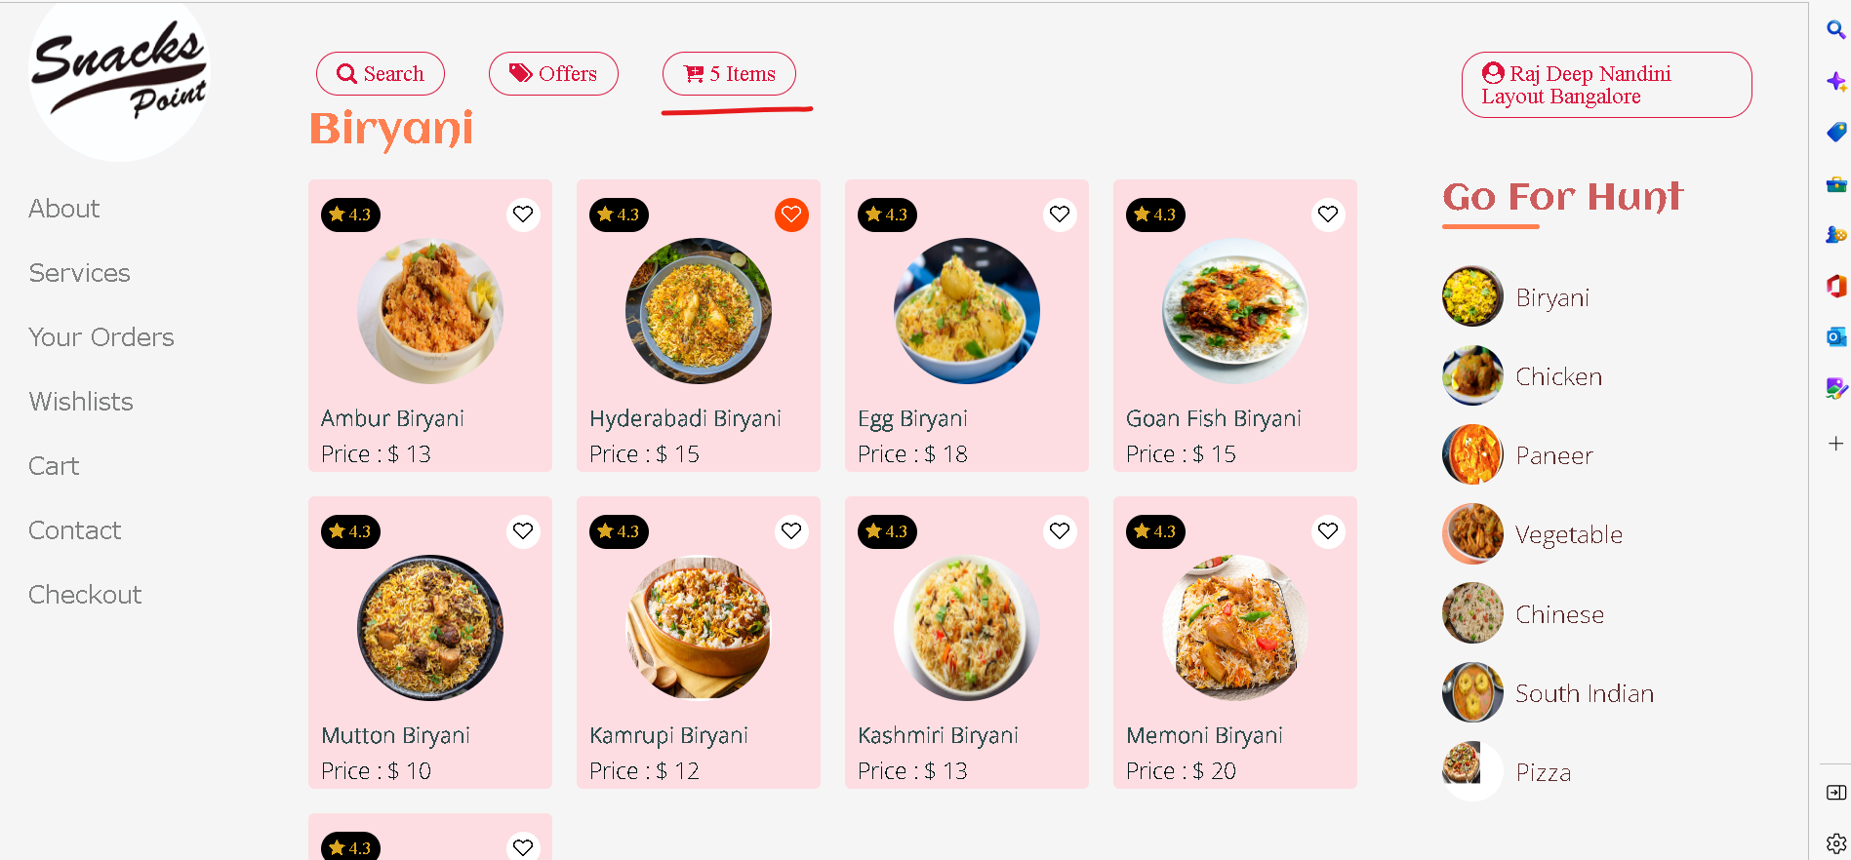
Now add item in wish list

Slide 17
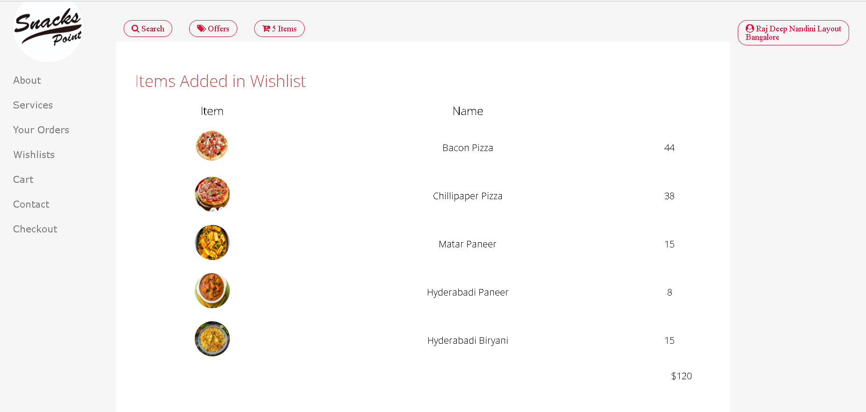
Now you can view all item present in cart

Slide 18
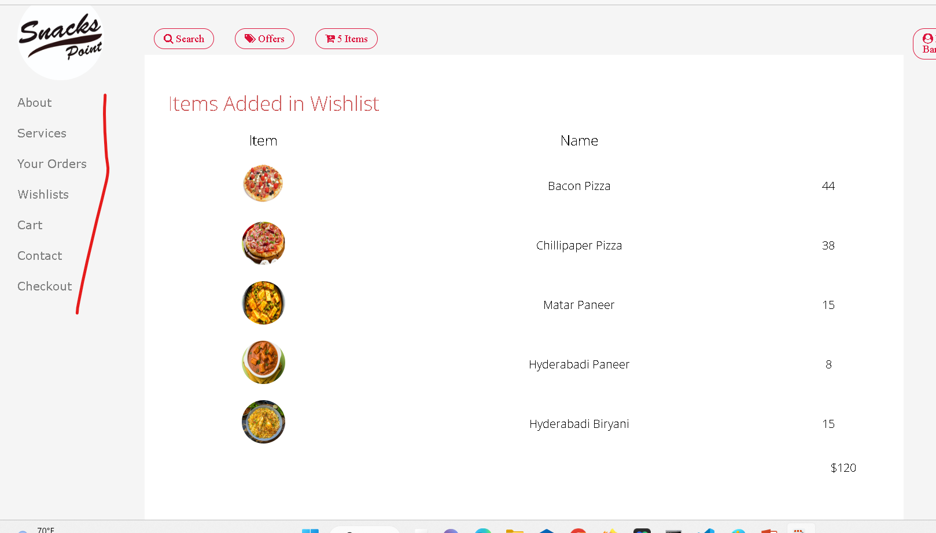
Other link are dummy

